Slide 1
Post Lymphedema Rehabilitation Device
by
Manthan Pawar
Guided by
Professor Vikram Kapila

Slide 2
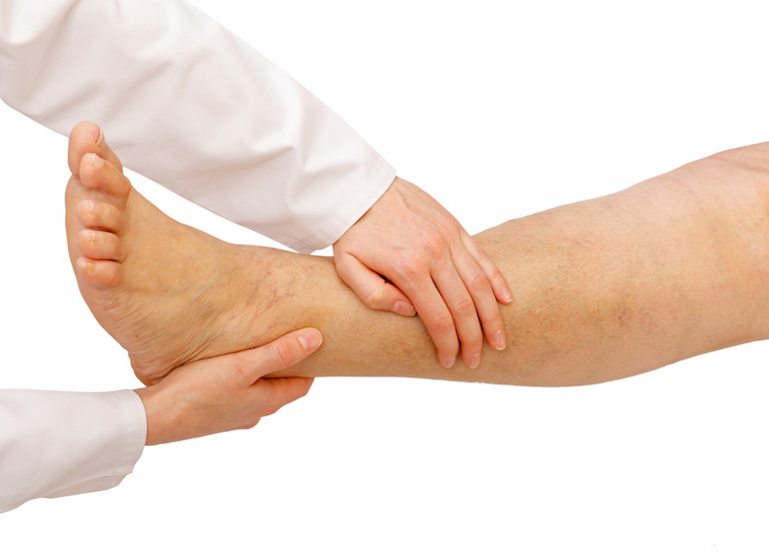
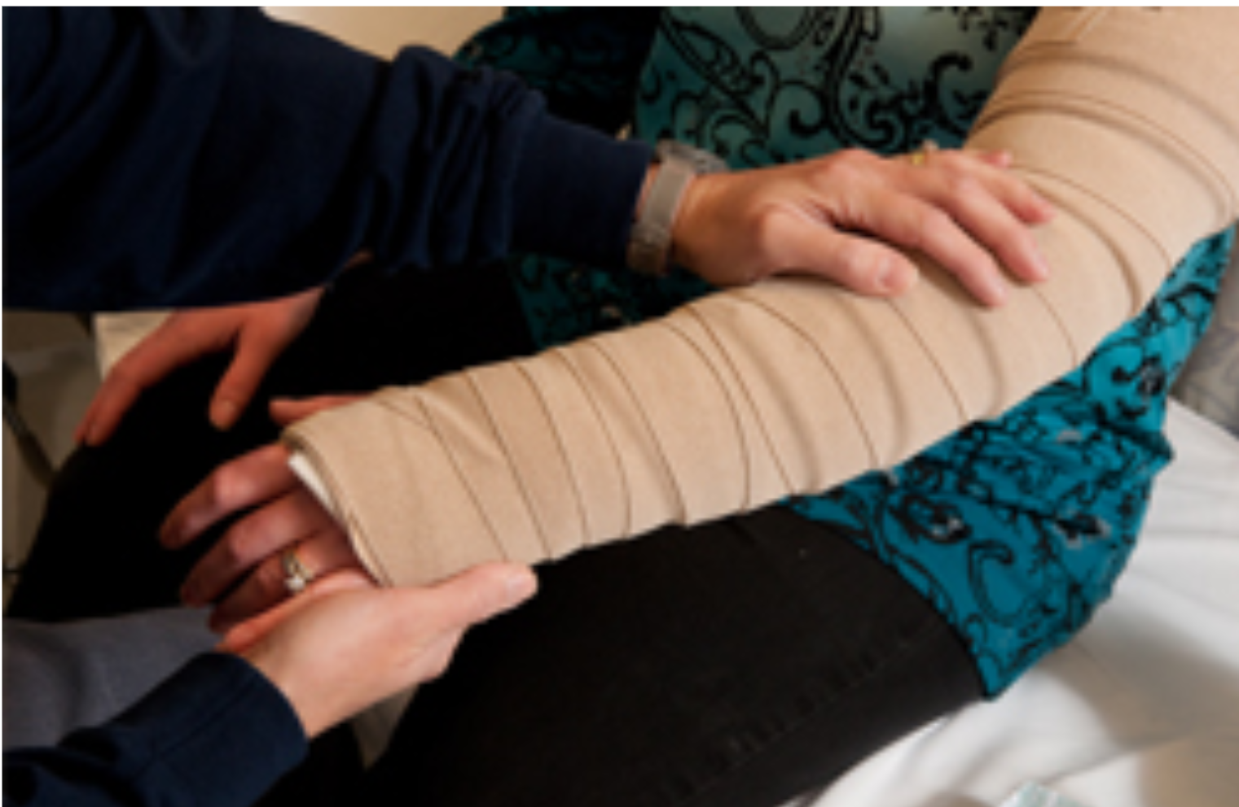
Current Lymphedema Rehabilitation
Complete Decongestive Therapy
Manual Lymphatic drainage (MLD) - to manually guide trapped lymph fluid out of the affected limb
Compression Bandaging - to keep the lymph fluid from building up further
Period
One-hour sessions, 4 to 5 days per week

Slide 3
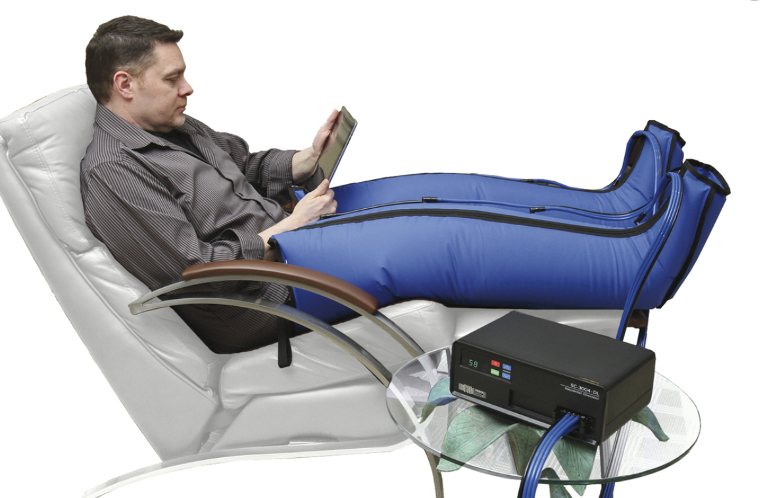

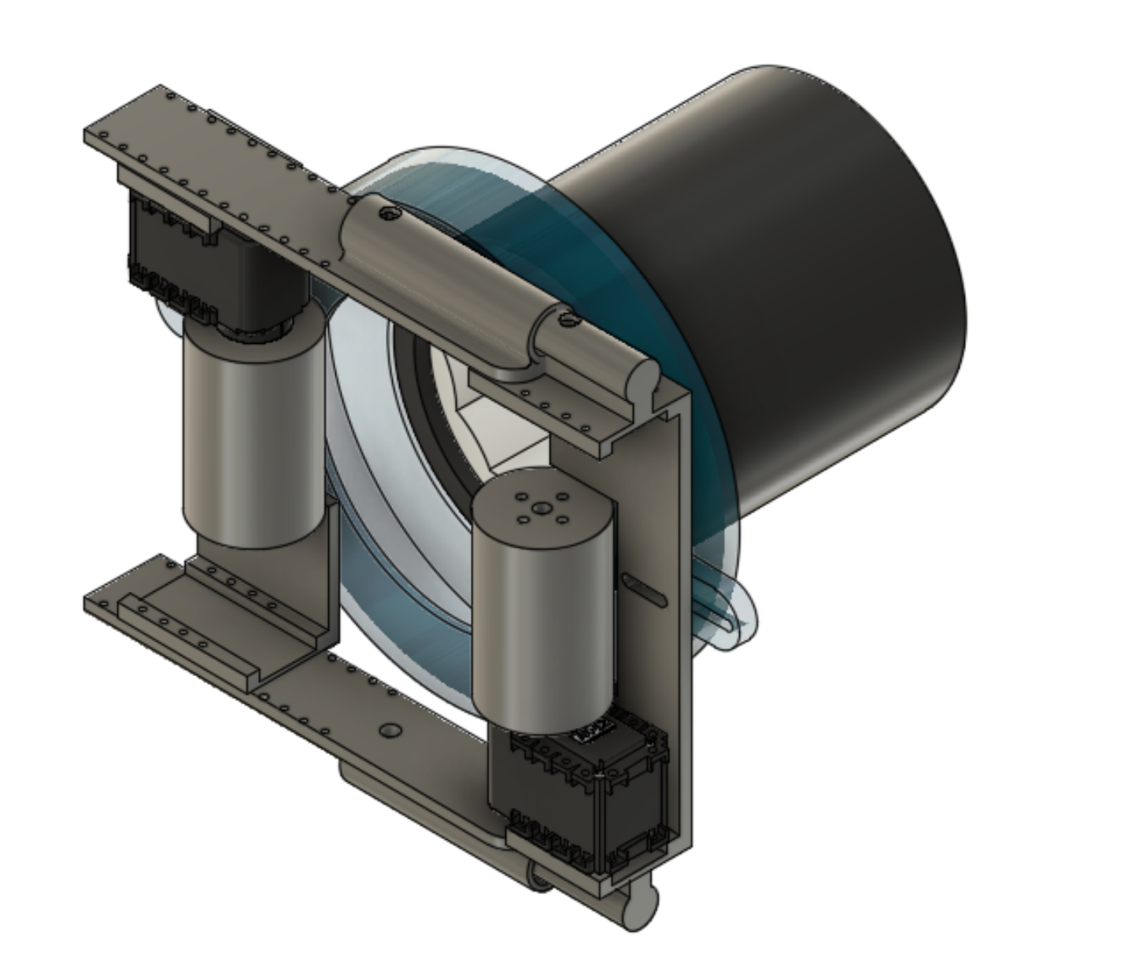
Mechatronic Solution Proposed
Current Device
Proposed Device

Slide 4
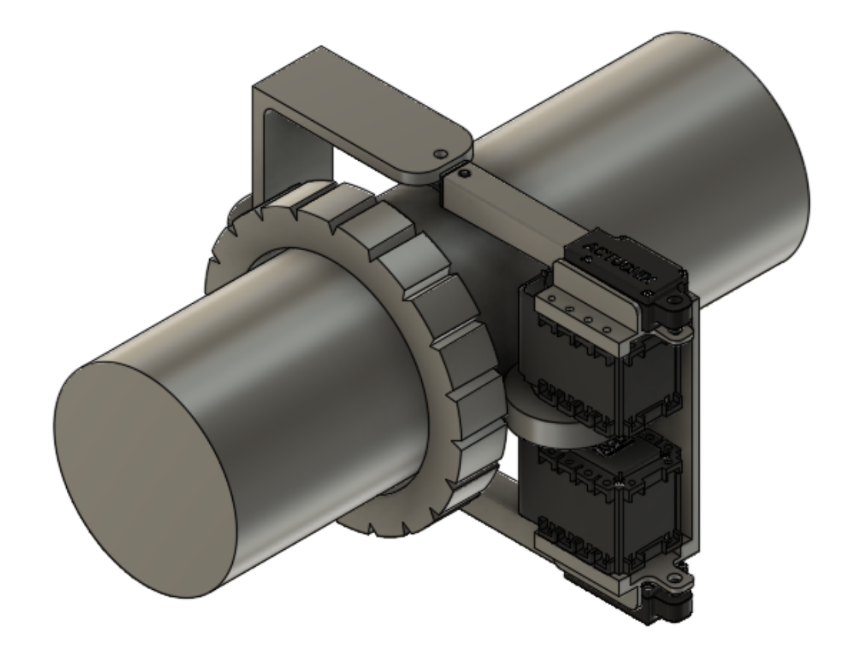
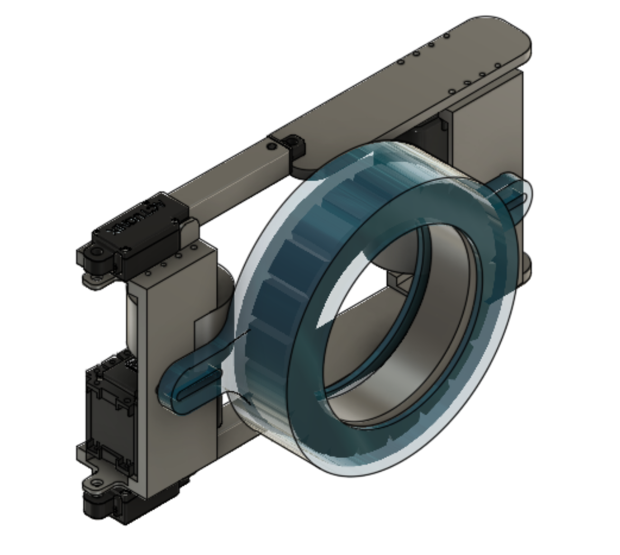
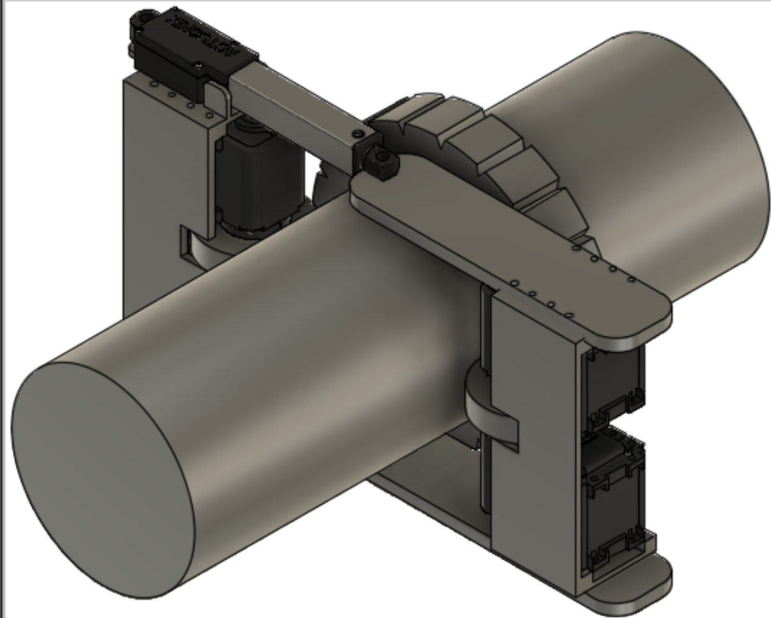
Progress Till Now
Version 29
Version 53

Slide 5
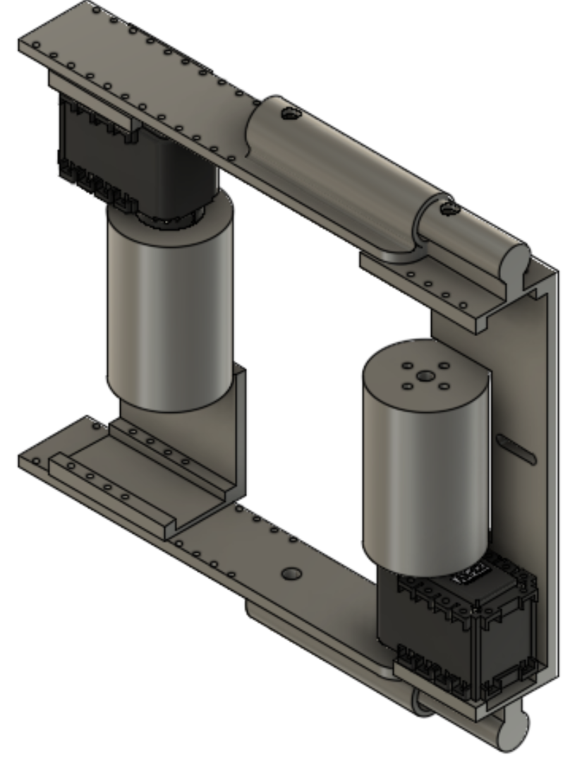
Current Work
Printed parts according to the recent version
Testing Limb Climbing Mechanism having AX12 motors.

Slide 6
Future Steps
Test Pressuring Cuff Mechanism having, Pneumatic pump and Silicone cuff
Test Feedback control using Flex Sensor and Force Sensor for diameter and pressure on limb readings respectively
Test Both climbing mechanism and Pressurizing mechanism together

